Slide 1
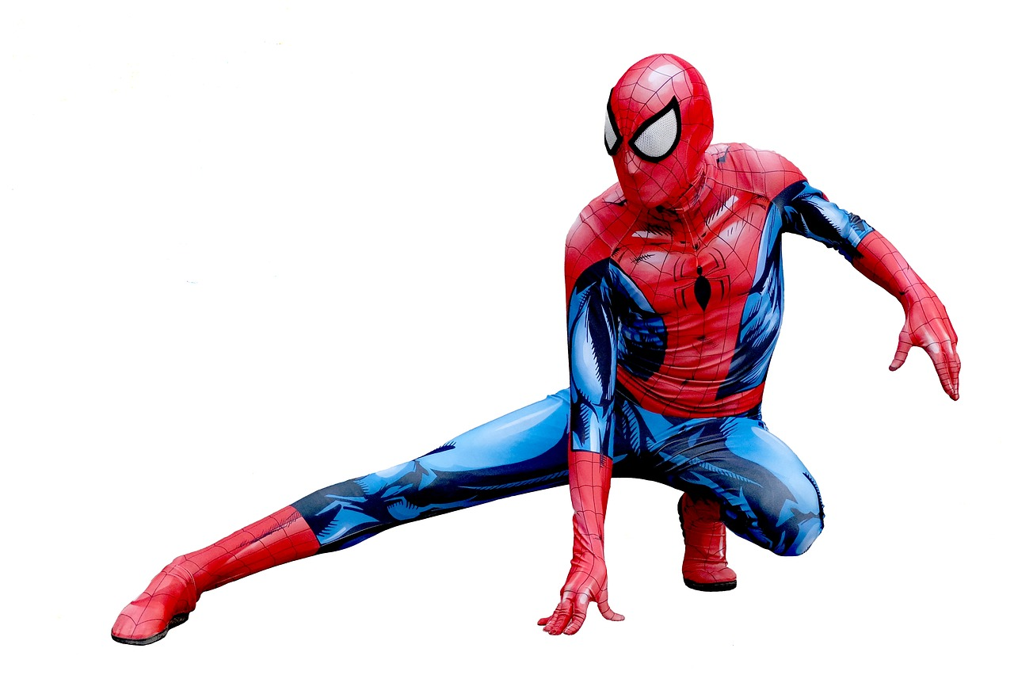
Spidey-Belt
Ryan M, Nicholas M, Garmy H, Hayden K, Aban K

Slide 2
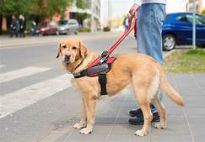
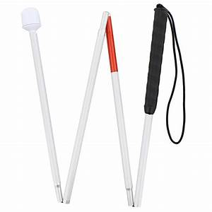
Sales Pitch
Previous uses for visually impaired used for getting around
Guide Dogs
Canes
Notes:
Hayden Kerekes:
Hi, the first sentence seems a bit off, try “Visually impaired persons traditionally use the following to navigate their path.”

Slide 3
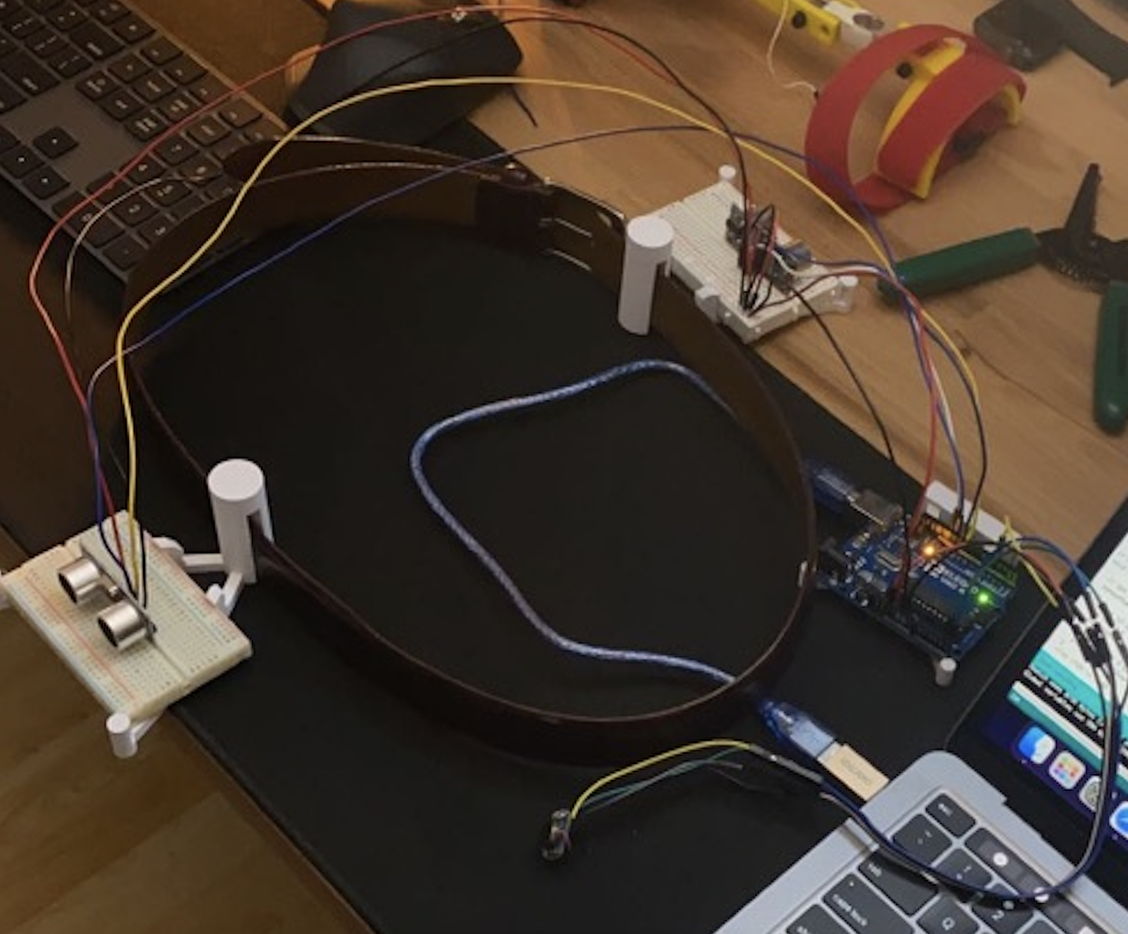
Sales Pitch
How will the Spidey-Belt help?
Provide a more inconspicuous way of getting around.
It is completely hands free!
Could also be used with a guide dog
Notes:
Hayden

Slide 4
How It Works
Using proximity sensors, we designed a belt attachment that will vibrate in the direction of close objects.
Two ultrasonic sensors are used to detect objects within the path, with a vibrating motor to identify both the direction and distance of the object.
Notes:
Aban

Slide 5
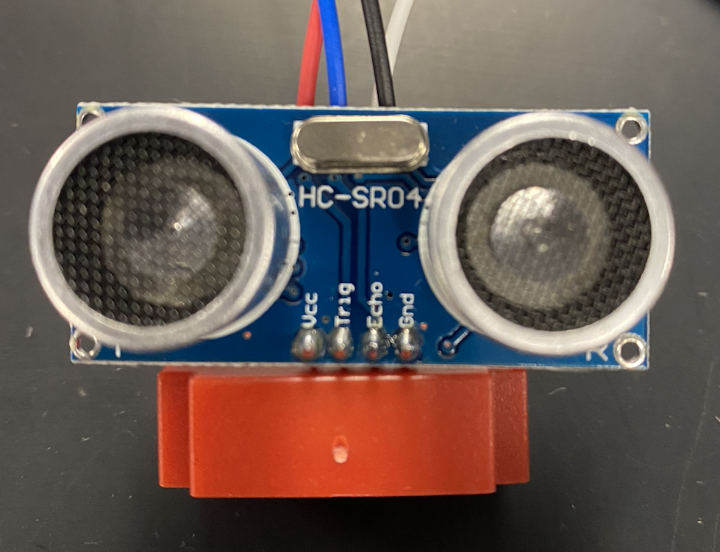
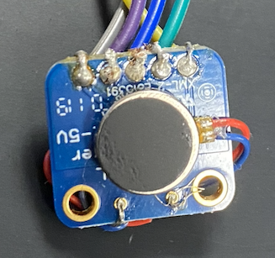
Arduino Sensors
Ultrasonic sensor HC-SR04 (2)
Adafruit DRV2605L with vibrating motors
Notes:
aban

Slide 6
Arduino Code
https://github.com/ryanmalani/spideybelt-arduino.git
Notes:
Ryan Malani

Slide 7
Physics Concepts: Kinematics
V= Vᵢ + at
V²= Vᵢ² + 2 aΔx
Δx= Vᵢt + ½ at²
Notes:
Garmy:
Some of the most important concepts in physics are kinematics because they relate the variables of motion to one another.
These equations allow for the calculation of either the final velocity at which an object is moving, in this case a Spidey-Belt user, as well as their initial velocity, the change in position or the total distance they traveled, as well as the change in time.

Slide 8
Problem 1:
A Spidey-Belt user travels 150cm in 2500 milliseconds. Considering they started at the average walking speed of 0.4 m/s, find a) the final velocity and b) the acceleration over that period:
a) v= 0.4 m/s, b) a= 0 m/s²
a) v= 0.6 m/s, b) a= 0.08 m/s²
a) v= 0.4 m/s b) a= 0.08 m/s²
a) v= 0.6 m/s b) a= 0.12 m/s²
Hint: pay attention to the units :)
Notes:
Garmy: You are testing out the brand new Spidey-Belt to workout any possible issue that may arise before release. To test this you decide to test how well it picks up moving objects.

Slide 9
2. a) v= 0.6m/s
b) a= 0.08 m/s²
And the correct Answer is :
Notes:
Garmy:
V=Δx/Δt → 1.5m/2.5s = 0.6 m/s
a= (V - Vᵢ) / Δt → (0.6 m/s - 0.4 m/s) / 2.5 = 0.2 / 2.5 = 0.08 m/s²

Slide 10
Problem 2:
Another Spidey-Belt user’s final walking speed is 0.5 m/s. Considering they walked for 5000 milliseconds, with an average acceleration of 0.04 m/s², find a) the appropriate kinematic equation to use, and b) their initial walking speed:
a) V²= Vᵢ² + 2 aΔx, b) vᵢ= 0.1 m/s
a) Δx= Vᵢt + ½ at² b) vᵢ= 0.8 m/s
a) V= Vᵢ + at b) vᵢ= 0.3 m/s
a) v= Δx/Δt b) vᵢ= 0.5 m/s
Hint: Pay attention to the givens in the problem :)
Notes:
Garmy:

Slide 11
3. a) v= vᵢ + at
b) vᵢ= 0.3 m/s
Correct Answer:
Notes:
Garmy
v= vᵢ + at
0.5= vᵢ + (0.04 m/s²)(5 s) → vᵢ = 0.5 - 0.2 → vᵢ= 0.3 m/s

Slide 12
What we would Add/Change
More motion sensors
This allows for more feedback of the surroundings
More vibration sensors
To be able to send that feedback to the individuals
Streamline the design
To make the product much more discrete and handfree
Improve the sensors
More accurate feedback
Change placement of the vibration sensor
Place on shoulders instead of being held
Notes:
Nicholas Mariel
First 2 add
Last 3 change
Add that the final design should be handsfree as written in the sales pitch.

Slide 13
Any questions?
Thank you :)

